Slide 1
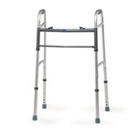
Fig. 1
l
m
Experimental conditions
Walker Vision Condition
None
NWV
WV
None
NWNV
WNV
Force platform

Slide 2
NWV
WV
NWNV
WNV
Fig. 2

Slide 3
Fig. 3

Slide 4
Fig. 4
*
*
*
*
*
*
*
*

Slide 5
Fig. 5
A.
*
*
*
*
*
*
B.

Slide 6
Fig. 6
*
*
*
*

Slide 7
Fig. 7

Slide 8
Fig. 8
A-∆COP
C-∆COP

