Slide 1
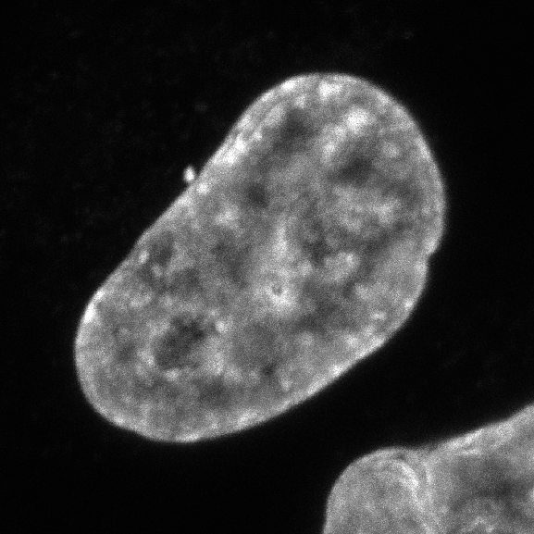
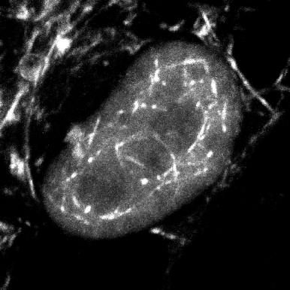
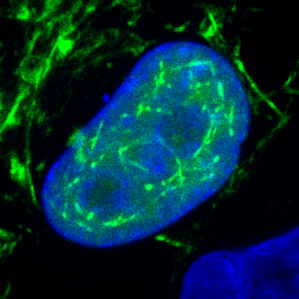
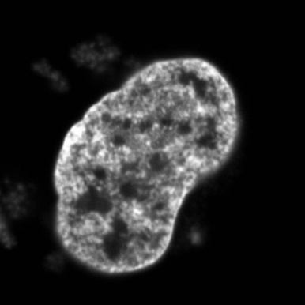
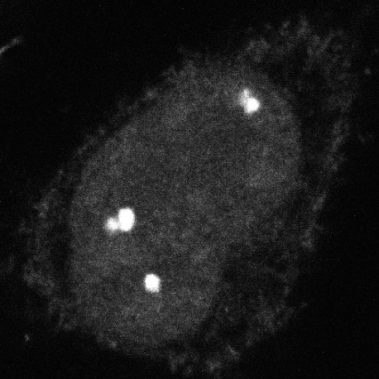
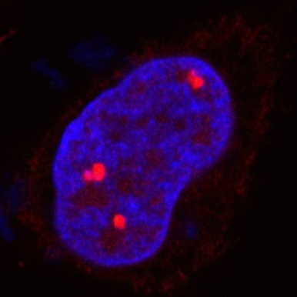
A
DAPI
EYFP-NLS-actin
Chanel for Alexa568
merge
B
DAPI
Chanel for
Alexa488
mCherry-
NLS-actin
merge
Suppl. Fig. S1

Slide 2
**
Relative increase of cells
**
**
**
Suppl. Fig. S2

Slide 3
Relative luciferase activity
Suppl. Fig. S3

Slide 4
**
Relative expression of TCF-1 to GAPDH
Suppl. Fig. S4

