Slide 1
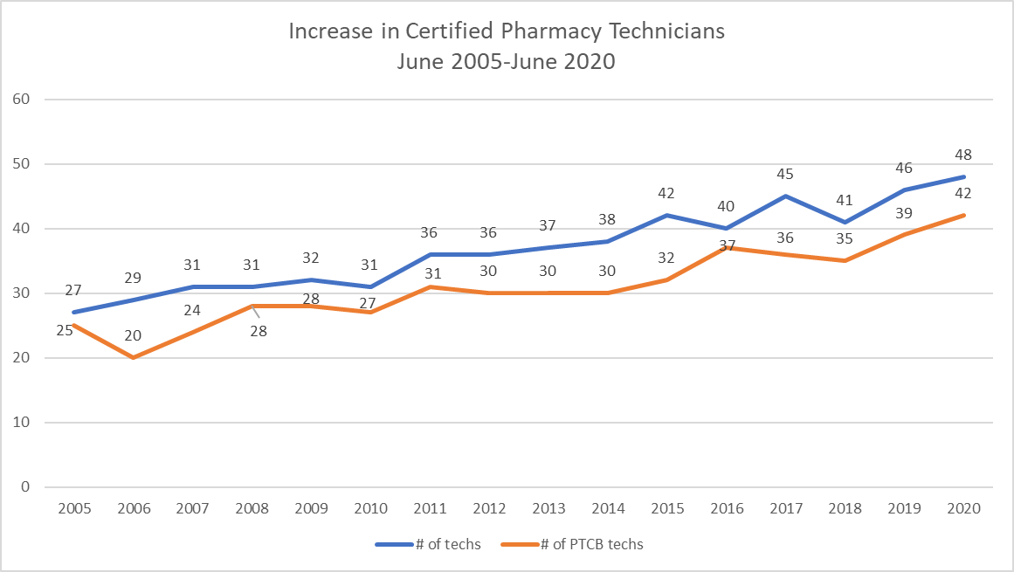
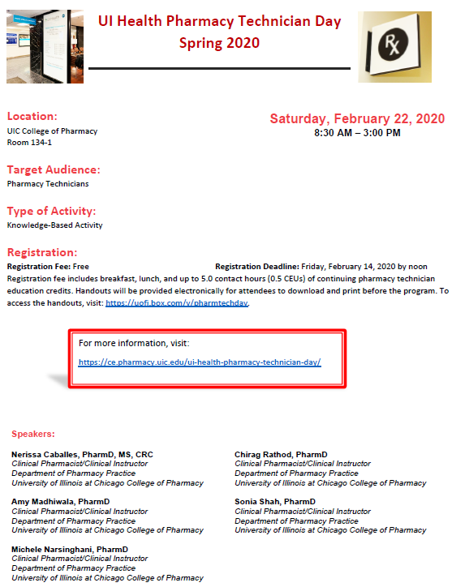
Fifteen years in review: Evolution of a pharmacy technician staff development and education program in an ambulatory care pharmacy practice setting
Annexiea L. Buford, CPhT; Mofoluwaso H. Ogunlari, PharmD Candidate; and Jewel S. Younge, PharmD BCPS
University of Illinois Hospital & Health Sciences System Department of Ambulatory Care Pharmacy Services
BACKGROUND
METHODS
METHODS (cont.)
RESULTS
Fifteen years ago only 59% (16/27) University of Illinois Hospital & Health Sciences System (UIH) Pharmacy Technicians were certified within the Ambulatory Care Pharmacy Department. Some technicians ‘allowed their certification to lapse’ due to lack of available Continuing Education (CE) credits.
UIH was required to respond to the Illinois Department of Professional Regulation, State of Illinois Mandatory Technician Training Legislation Section 17.1, Pharmacy Technician Training: As of January 1, 2004, it is the joint responsibility of a pharmacy and its pharmacist in charge to train pharmacy technicians or obtain proof of prior training in six specific topics related to the practice site within 6 months after initial employment.
The Pharmacy Technician Staff Development and Education Program (PTSDEP) began in 2005.
Pharmacist and pharmacy externs volunteered to present a minimum of 10 hours of continuing education every 2 years on specific topics that were identified in a survey completed by pharmacy technicians.
The CE program started with quarterly, manual-based, classroom, video and web-based trainings, delivered as 1-hr free CEs during two, staggered, lunch-hour sessions. The in-service option allowed pharmacy technicians to complete half of all CE credits through the workplace.
State mandated topics included duties and responsibilities of technicians, task and policies & procedures, compound packaging and labeling, pharmaceutical and medical terminology, record keeping, and calculations
Between 2005-2008, 8 technicians became certified and 6 technicians recertified, and 16 CE courses were offered.
In 2010, Illinois mandated that all registered pharmacy technicians, within two years employed, must become certified by successfully passing the Pharmacy Technician Certification Board (PTCB) examination in order to continue to perform pharmacy technician duties.
In 2019, UIH partnered with the Office of Continuing Education and Meeting Services Department (OCEMS) to offer all pharmacy technicians a minimum of 20 hours of Accreditation Council of Pharmacy Education (ACPE) credits.
Our method was to provide 20 hours of continuing education (CE) credits within two years for UI Health Pharmacy Technicians.
During Pharmacy month, October 2019, UI Health Pharmacy technicians were asked to participate in a Pharmacy Technician Continuing Education Program survey.
From this survey technicians were asked if they would be interested in a Pharmacy Technician CE Day held on Saturdays, with what frequency, what topics of interest, and what preferred format for CE credits.
Results of the survey were shared with, and approved by, Pharmacy Senior Leadership (Director of Pharmacy Services and Senior Associate Director of Ambulatory Pharmacy Services).
CE presenters were recruited through a new partnership with the Office of Continuing Education and Meeting Services (OCEMS) Department and of no charge to the technicians.
OCEMS provided notification about the program agenda in ample time to publicize the event. OCEMS created an online registration portal, which they made accessible via a link, allowing registrants to view the CE Day agenda, as well as a link to the CE hand outs.
As a result of the PTSDE Program, technicians no longer ‘allow their certification to lapse’ due to lack of available CEs.
The revamped program provides technicians with CE courses that are appropriately tailored to health care and job specific issues that are relevant to their roles within the department.
PTSDEP provides 20 hours of CE credit within 2 years covering the minimum areas of law, patient safety, medication errors and sexual harassment.
The percentage of certified technicians has increased as of June 2005, from 59 % (16/27) to 88% (42/48) in June 2020.
CONCLUSION
The Staff education program has continued to grow over the course of the past fifteen years.
100% of certified technician have recertified in a timely manner.
Average attendance has grown from 10 people to 45 people.
30 technicians attended the first semi-annual Pharmacy Technician CE Day on Saturday, February 22nd, 2020.
Meals (breakfast and lunch) were provided to all attendees and speakers.
The implementation of the pharmacy technician staff development and education program in the workplace has been effective in increasing the number of certified pharmacy technicians.
OBJECTIVES
ACKNOWLEDGEMENTS
The objective of the Pharmacy Technician Staff Development and Education Program (PTSDEP) is to assist certified Pharmacy Technicians to obtain and maintain certification with the Pharmacy Technician Certification Board (PTCB).
Andrew J. Donnelly, Director of Pharmacy Services
Sandra F. Durley, Senior Associate Director of Ambulatory Pharmacy Services
Mary L Moody, Clinical Associate Professor and Clinical Pharmacist
April R Quarles, Visiting Clinical Instructor/Clinical Pharmacist

