Slide 1
An Introduction to Interprofessional Collaborative Practice
Mary T. Keehn, PT, DPT, MHPE
Director of Interprofessional Education – Office of the Vice Chancellor for Health Affairs
Associate Dean for Clinical Affairs – College of Applied Health Sciences
University of Illinois at Chicago
Notes:
Hello – My name is Mary Keehn and I am introducing the topic of Interprofessional Collaborative practice as a way of practicing and providing health care services that has gained a great deal of worldwide support over the past 20 years.
The learners viewing these presentations come from different health professions education programs and some concepts will be less familiar to learners from some programs than for others. In those cases, we have provided links to supplement materials so you can fill in any gaps in your understanding

Slide 2
Foundations of Interprofessional Collaborative Practice
Conceptual Frameworks for Interprofessional Collaborative Practice
Notes:
we are going to look at conceptual frameworks that support interprofessional collaborative practice.

Slide 3
Conceptual Frameworks for ICP
(IPEC) Core Competencies
WHO International Classification of Functioning, Disability & Health
Triple or Quadruple Aim
Notes:
Conceptual frameworks are useful when we try to understand a complicated concept – they help to present the elements that are most critical to the concept and how they are related.
There are 3 conceptual frameworks that we will explore in this video and those are the IPEC Core Competencies for Interprofessional Collaborative Practice, the Triple Aim – now expanded to the Quadruple AIM and the WHO International Classification of Functioning, Disability and Health.

Slide 4
The Core Competencies for Interprofessional Collaborative Practice
Notes:
The Core Competencies for Interprofessional Collaborative Practice were originally described by the Interprofessional Education Collaborative or IPEC in 2011 through a consensus-based process that was sponsored by 6 academic associations.
The competencies were updated in July 2016 to include a greater focus on population health. Over time, additional groups have endorsed the competencies and now there are 21 academic associations who are part of IPEC.
The Core Competency framework put together by IPEC has been used to promote understanding of ICP and there are several research groups working to validate the competencies and to develop methods to use them in developing Interprofessional education curriculum and in assessing collaborative competence.

Slide 5
Interprofessional Collaboration Competency Domain
Notes:
Let’s look closely at this diagram of the framework which is included in the 2011 report.
You will see that the development of competence in interprofessional collaborative practice s a lifelong process – this is represented by the arrow at the bottom of the diagram.
You will also note that interprofessional collaborative competence is shown as having four competency areas within the overall domain of Interprofessional Collaboration. These are - Interprofessional Teamwork and Team-based Practice, Interprofessional Communication Practices, Role and Responsibilities for Collaborative Competence and Values/Ethics for Interprofessional Practice. Within each of these areas of competence are subcompetencies which provide very helpful detail about the behaviors that are foundational to interprofessional collaboration.
These competencies have been widely adopted and provide a very robust picture of what it takes to be competent to collaborate as part of an interprofessional team.
Finally you will see that Competence in interprofessional collaboration occurs with the context of patient and family centered care that is community and population oriented. This is represented by the concentric rings which surround the four competency areas

Slide 6
4 Areas of Competence for Interprofessional Collaborative Practice
Values/Ethics
Work with individuals of other professions to maintain a climate of mutual respect and shared values.
Notes:
Now let’s look at how IPEC explains each competency area.
Values & ethics competency require the ability to work with individuals of other professions to maintain a climate of mutual respect and shared values.

Slide 7
4 Areas of Competence for Interprofessional Collaborative Practice
Roles & Responsibilities
Use the knowledge of one’s own role and those of other professions to appropriately assess and address the health care needs of patients and to promote and advance the health of populations
Notes:
Competence in the area of Roles & Responsibilities includes using the knowledge of one’s own role and the roles of other professions within a specific team to appropriately assess and address the health care needs of patients and to promote and advance the health of populations

Slide 8
4 Areas of Competence for Interprofessional Collaborative Practice
Interprofessional Communication
Communicate with patients, families, communities and professionals in health and other fields in a responsive and responsible manner that supports a team approach to the promotion and maintenance of health and the prevention and treatment of disease.
Notes:
Interprofessional Communication competence requires communication with patients, families, communities and professionals in health and other fields in a responsive and responsible manner that supports a team approach to the promotion and maintenance of health and the prevention and treatment of disease.

Slide 9
4 Areas of Competence for Interprofessional Collaborative Practice
Teams and Teamwork
Apply relationship-building values and the principles of team dynamics to perform effectively in different team roles to plan, deliver, and evaluation patient/population centered care and population health programs and policies that are safe, timely, efficient, effective and equitable.
Notes:
And finally, competence in the areas of teams and teamwork is the ability to apply relationship-building values and the principles of team dynamics to perform effectively in different team roles to plan, deliver, and evaluate patient/population centered care and population health programs and policies that are safe, timely, efficient, effective and equitable.

Slide 10
4 Areas of Competence for Interprofessional Collaborative Practice
Values/Ethics
Roles & Responsibilities
Interprofessional Communication
Teams and Teamwork
Work with individuals of other professions to maintain a climate of mutual respect and shared values.
Use the knowledge of one’s own role and those of other professions to appropriately assess and address the health care needs of patients and to promote and advance the health of populations
Communicate with patients, families, communities and professionals in health and other fields in a responsive and responsible manner that supports a team approach to the promotion and maintenance of health and the prevention and treatment of disease.
Apply relationship-building values and the principles of team dynamics to perform effectively in different team roles to plan, deliver, and evaluation patient/population centered care and population health programs and policies that are safe, timely, efficient, effective and equitable.
Notes:
It is important to note that the revisions made to the competencies in 2016 were prompted in part by the groups collective belief that there was a need to be more explicit about population health and you can clearly see that emphasis reflected in these descriptions.

Slide 11
IHI Triple Aim Framework
Notes:
Moving on from the IPEC Core Competencies, let’s talk about the Institute for Healthcare Improvement's Triple Aim Framework.
The Triple Aim Framework is a widely recognized way of depicting the ultimate goals for health care in the US. The IHI advocates for individual health care organizations and the government to simultaneously look at all the aims in redesigning the US health care system to address the significant problems that we face in health care today. Among the things that are needed to achieve the Triple Aim are uniform measurement of health and health care outcomes, the integration of behavioral health into models of primary care and increased focus on particularly vulnerable populations such as the fragile elderly and people with disabilities.
In 2014, Thomas Bodenheimer – a family physician, advocated for the addition of a 4th Aim – and that was provider well-being. His focus was on physician burnout but subsequently the idea of provider has been broadened to include “Care Team Well-Being”.
Increased use of Interprofessional Collaborative Practice models is a perfect fit for achieving the Quadruple AIM.

Slide 12
The Quadruple Aim
Notes:
In 2014, Thomas Bodenheimer – a family physician, advocated for the addition of a 4th Aim – and that was provider well-being. His focus was on physician burnout but subsequently the idea of provider has been broadened to include “Care Team Well-Being”.
Increased use of Interprofessional Collaborative Practice models is a perfect fit for achieving the Quadruple AIM.

Slide 13
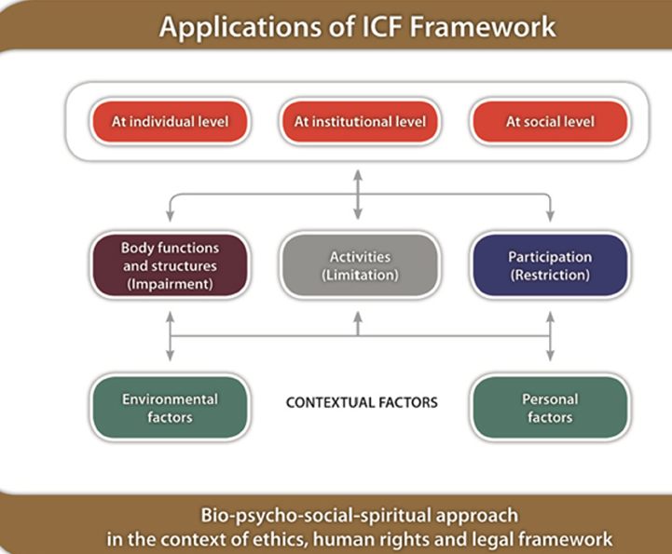
WHO – International Classification of Functioning, Disability & Health
Social Determinants of Health
Notes:
The following conceptual framework comes from the World Health Organization
And the full name is the International Classification of Functioning, Disability and Health, but it is commonly referred to as the ICF Model or just the ICF
Historically, health care was narrowly focused – based in a biomedical model of health which assumed that health is primarily dependent on biological processes and medical care. As state at the bottom of the diagram, the ICF is based on a biopsychosocial framework which depicts health as being derived from biological, psychological and social factors.

Slide 14
Biopsychosocial Approach to Health
Biological
Organ system function and dysfunction
Psychological
Mood, knowledge, spirituality
Social
Socioeconomic , Environment, Personal Safety
Notes:
Biological factors include not only the condition of the person’s body but also the impact of pathogens, injuries and abnormalities on organ systems and tissues.
Psychological components of health , such as mood, knowledge, spirituality and attitude are given equal importance to biological factors as determinants of health.
Finally social factors such as socioeconomic conditions, environmental conditions and exposure to adverse or traumatic events are recognized as having great impact on a person’s health.

Slide 15
Social Determinants of Health
Economic Stability
Neighborhood and Built Environment
Health and Health Care
Social and Community Context
Education
Notes:
There is currently an increasing focus on the importance of the Social Determinants of Health in looking at overall health care outcomes. If the SDH are a new concept for you , click on the link https://www.healthypeople.gov/2020/topics-objectives/topic/social-determinants-of-health to get more information.

Slide 16
The ICF Components
Body Structure and Function
Examples – Breath, Circulate blood, Take in food, digest it and eliminate it
Activity
Examples - Walking, Talking, Reaching, Thinking
Participation
Examples - Holding a job, Being a student, Being an athlete or Travelling as a tourist
Notes:
If you look at the center of the diagram you will see three terms- body functions and structures, activities and participation.
Body function and structures are straightforward – it is the ability to do such things as breath, to circulate blood, to take in food, to digest it and to eliminate it. Activities are things that a person does in daily activities such as walking, talking, reaching, thinking. Finally Participation refers to a person’s engagement in society or life –things such as holding a job, being a student, being an athlete or travelling as a tourist. When someone has impaired body function and structures – an illness or injury – they come to the health care system for help with the biological problem. However, in many cases unless psychological and social issues are also recognized and addressed, health (as defined by the WHO) will not be restored.

